Slide 1
GPUs
Finally – cool(er) hardware!

Slide 2
A taxonomy of problems
As we talked about in Amdahl’s Law, each problem has a parallel part and a serial part.
Let’s take another look at that.
Is there a limit to parallelism?

Slide 3
Types of Problems
Completely serial (every step depends on every previous step)
We can’t really do anything with this
Partially parallelizable – some part can be done in parallel, some cannot
Amdahl’s is perfect for finding the speedup here
Embarrassingly (or pleasantly) parallel – no dependencies at all!
Here we can throw more and more hardware at the problem!

Slide 4
Consider an example
Assume that we have an infinite army of “workers”
We want to check 100 numbers for primeness? This is embarrassingly parallel! No dependencies!
How can we do this most effectively?
With no timing, I can just give the 100 numbers to a worker and get a response of the primes. We need to think about timing.

Slide 5
Timing
This makes a lot of sense if:
I can shout instructions to all the workers:
“When you get a number, tell me the number and if it is prime”
All workers are doing the same work (otherwise instruction time will overwhelm the work)
Handing out numbers is much quicker than giving instructions
Handing out numbers is much quicker than doing the math myself
The workers can understand and do the work

Slide 6
Data Parallelism
It is not uncommon that we need to do the same operations on a lot of pieces of data:
for (a in array)
doSomething(a)
Examples: Image/sound/video processing, matrix operations, AI

Slide 7
Serial Code
In order for code to be parallelizable, loop iterations must be independent.
for (int i=0;i<N;i++)
a[i] = a[i-1] + a[i-2];
This code is not reasonably parallelizable, barring some hardware tricks…

Slide 8
What sort of hardware would we like?
We have seen processes and threads and multi-core.
But there is a lot of complexity in those processors.
What if we could have a simpler design, but (in exchange for simplicity) get a lot of cores?

Slide 9
Our simplified computer design (SISD)
I/O Bus (PCI Express)
Video
Network
Cache
Memory Interface
USB
Registers
ALU
Memory

Slide 10
Multi-Core with Hyperthreading (MIMD)
I/O Bus (PCI Express)
Video
Network
Shared Cache
Memory Interface
USB
Cache
Cache
Registers
Thread1
ALU
Registers
Thread1
ALU
Memory
Registers – Thread2
Registers – Thread2

Slide 11
GPUs
Video
GPUs (graphics processing units) were originally designed for accelerating computer graphics (games and other 3D like data visualization)
Researchers realized that they needed to do the same sort of parallel processes that computer graphics did.
GPUs also moved from a fixed pipeline to a programmable pipeline as games got more demanding.

Slide 12
A quick primer on 3D graphics
Graphics are a significant topic – there are entire courses about them.
The basics help us to understand what the hardware was designed for.
Definitions:
3D = 3 dimensions
Point = (x,y,z) where x ~ left-right, y ~ up-down, z ~ in/out
Vertex = point that is a “corner” of a 3D object
Scene – collection of 3D objects, camera, lighting

Slide 13
How do we work with a 3D scene
We move 3d objects (translation, rotation)
We move the camera
We alter the lighting
We “render” – we make a 2D representation as seen through the camera

Slide 14
Moving 3D objects
A 3D object is a collection of vertices
We can make a matrix to transform the coordinates of our 3D object:
Translate (Move)
Scale
Rotate (z axis)
x
y
z
1
1 | 0 | 0 | 0
0 | 1 | 0 | 0
0 | 0 | 1 | 0
δx | δy | δz | 1
sx | 0 | 0 | 0
0 | sy | 0 | 0
0 | 0 | sz | 0
0 | 0 | 0 | 1
cos θ | sin θ | 0 | 0
-sin θ | cos θ | 0 | 0
0 | 0 | 1 | 0
0 | 0 | 0 | 1

Slide 15
Lighting
There are two kinds of lights – ambient and local
Ambient light is added to every part of the image (sunlight for example)
Local light is added to some parts of an image and decreases over a distance (like a flashlight beam)

Slide 16
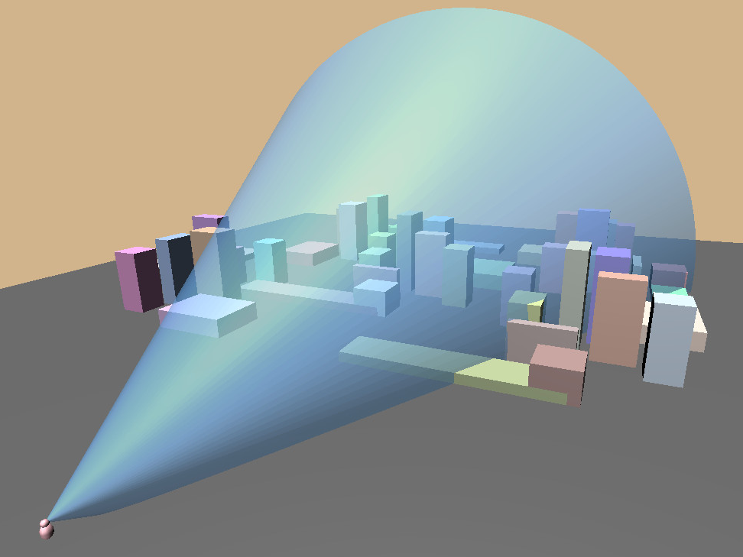
Rendering
Once we “know” where our vertices, camera and local light sources are, we can consider what the scene should look like.
We direct a cone out from the camera. Any object (or portion thereof) in the cone is part of the scene.
The intersection of a “slice” of that cone and the object is the position on the screen.

Slide 17
Occlusion
One important thing to consider with rendering is that one object might hide another (i.e., be positioned in front of relative to the camera).
Once we “find” a pixel through a “slice”, we don’t replace it.
This is also a convenient optimization – if a surface is “behind” another, we don’t have to consider it.

Slide 18
Texture Mapping
Once we know how the flat surfaces are mapped onto screen, we can consider what they look like. Plain surfaces were the norm in the 80’s.
In the 90’s, we started supplying an image that shows what the surface looks like if viewed from head-on and well lit.
The GPU can skew, scale and rotate the image to “apply” it to the surface.

Slide 19
Bump Mapping
Perfectly flat surfaces are rare (even a brick building, if you get close enough, has roughness).
Modelling this roughness with vertices is computationally expensive.
Bump mapping is the process of supplying a “height map” – like a texture map but showing the change in height for an area of the surface.

Slide 20
Final processing
There are several effects that we might want to add:
Fog
Motion blur
Anti-aliasing (smoothing)
Reflections
2D (HUD, overlay text)

Slide 21
Evolution of Design
Original hardware was hardwired to do these rendering functions.
As graphics developers wanted to work outside of the “bounds” of the hardwired functionality, hardware manufacturers exposed more detail.
NVIDIA (2001) GeForce3 exposed an internal instruction set (it had been a CPU all along!).
Consider the scale – 60 frames per second, hundreds of thousands-millions of triangles (each with 3 vertices!).

Slide 22
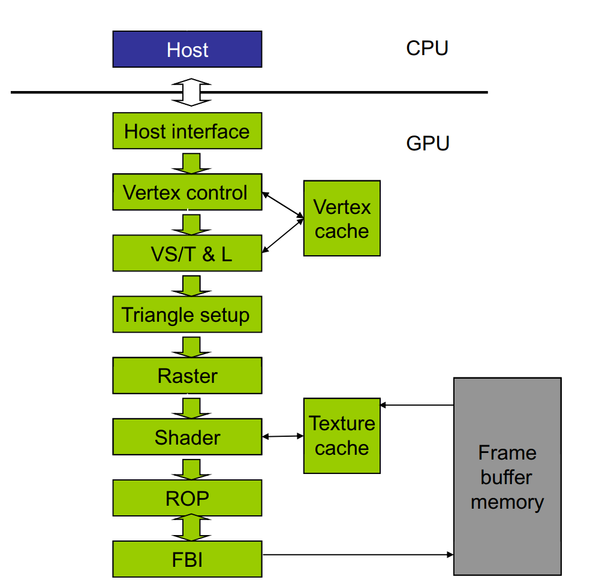
(Old) Fixed Function NVIDIA GeForce Pipeline
VS/T = Vertex shading, transform, lighting
Triangle = trace edges for interpolation
Raster = Convert floating point coordinates to pixels
Shader = determine final colors of pixels
ROP = Raster Operations – blending/anti-aliasing, determine visibility
FBI = frame buffer interface – write pixels out to memory that the video out can see

Slide 23
Limitations of these designs
Note that there is no output except to the frame buffer
Frame buffers accesses are linear (no writing to memory except to output pixels)
To get results, you output to the frame buffer, then use that frame buffer as a texture. Once “pulled back” into the GPU, it could be read back to the CPU.

Slide 24
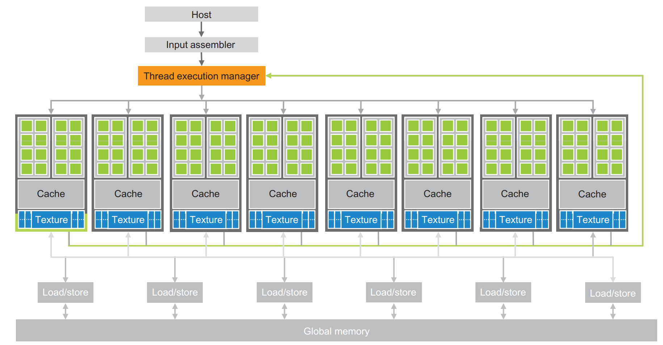
More modern architecture

Slide 25
Key Architecture Points
Many cores, all running the same instruction
- This helps to gives us the simplicity of hardware
Each core is accessing different data (SIMD)
More than one program can be running, each program dedicated to a set of cores
Cores have limited instructions and no access to main memory (typically)
- More simplicity

Slide 26
No access to main memory? Sharing Data
The general flow for a program using the GPU is:
initialization & loading data to main memory (CPU)
transfer data to GPU (PCI-E)
run code on GPU (GPU)
transfer results to main memory (PCI-E)
print/save results (CPU)

Slide 27
Hardware organization
When code comes to the GPU, it is processed by the thread scheduler.
There are some number of cores that all run the same instruction.
The thread scheduler sends a program counter to the group and parameters to each unit. The units then run like any CPU.

Slide 28
Logical Organization
Your code may want more threads than the hardware provides in a single block of cores. The GPU handles this for you by providing in the API a way to express your needs. The thread manager then maps your organization to the design of the hardware.
Unfortunately, there are different standards for naming:
NVIDIA (CUDA)
nearly everyone else(OpenCL or Vulkan)
Apple (Metal)

Slide 29
Nomenclature
Concept | CUDA | OpenCL
code for the GPU | kernel | kernel
code ready to run | thread | work-item
all threads w/ same code | grid | multi-dimension range
subgroup of threads | block | work-group
hardware to execute code | streaming multiprocessor (SM) | SIMD
division of threads all on the same hardware | warp (32) | wave
Logical Organization
Hardware Organization
I will be using CUDA/NVIDIA for now

Slide 30
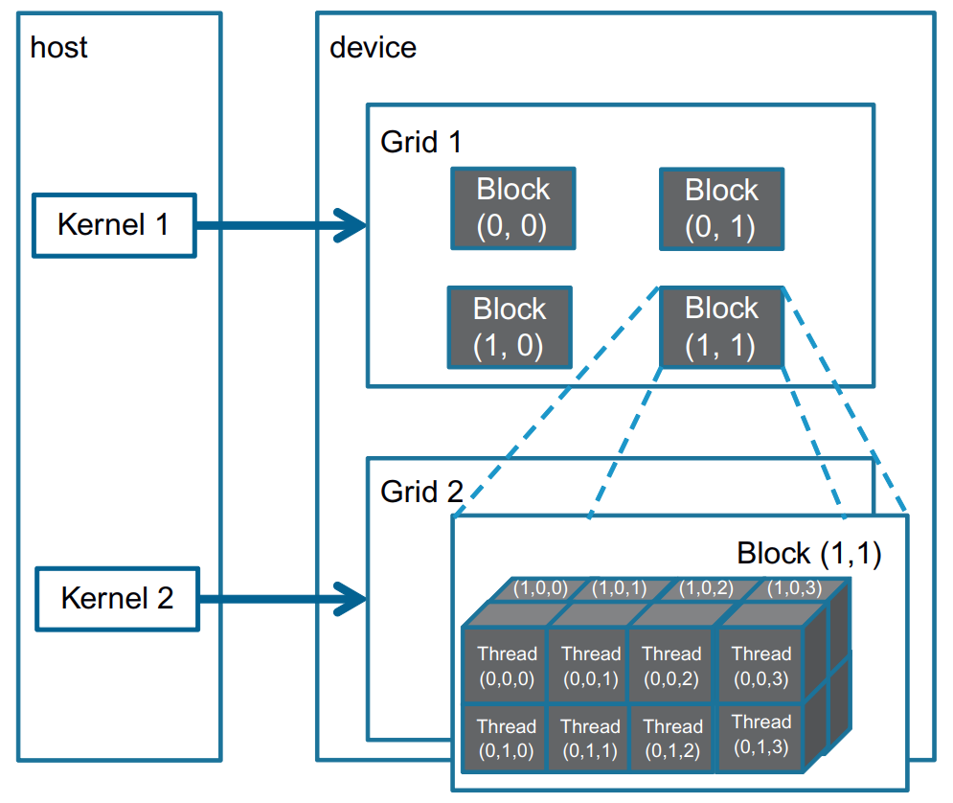
Grids and Blocks
A grid is a 3d array of blocks.
A block is a 3d array of threads.
This makes a lot of sense if you are dealing with 3d data, like graphics.
If your data is not intuitively 3d, you can size one or two of your dimensions as size “1”, effectively making that dimension disappear.
Note – all blocks in a grid must be the same size.

Slide 31
Logical Organization and Parameters
The question might occur – if we are running the same code on many cores, how can we point the code at different data so that our whole dataset is processed.
The answer comes in our logical organization. We describe to the thread manager how we perceive our data; it then passes to each thread which grid/block/thread we are in.

Slide 32
Conclusion
GPUs have a LOT of cores available, but they can only do (basic) math
There is a significant time cost to sending your data to the GPU and getting results back; sometimes it is not worth that cost.
Much like our CPU, there is a cost to accessing memory in the GPU.

